Slide 1

Case study Brazil housing
Learner Name : Sakshi Laxman Waghmare
Mentor Name : Shruti Gode

Slide 2

Business objectives :
Companies allowing work-from-home facilities for 40% employees, employees wants to relocate the cities that supports remote living and work.
Select the suitable cities for relocating bachelors.
Select the suitable cities for relocating Mid-size families.
Select the suitable cities for relocating Large-size families.
1
2
3

Slide 3
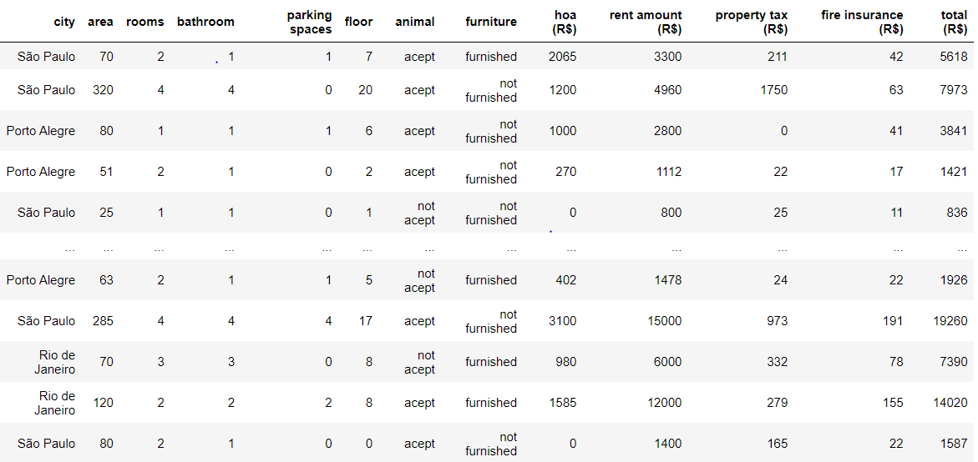
DATASET

Slide 4
Notes :
Rio De Janeiro and Sao Paulo are among the most expensive cities to live in Brazil, People from this cities are considering relocating to the different cities.
The total amount is the sum of property tax, HOA fees, fire insurance, and rent. However, property tax, HOA fees, and fire insurance are covered by the landlord. Therefore, we are only considering the rent amount for operations.

Slide 5
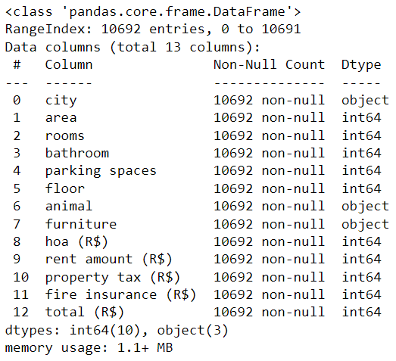

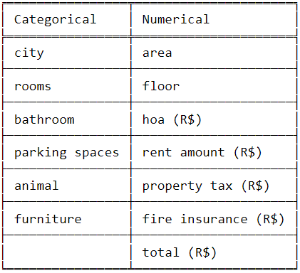
DATA preprocessing

Slide 6
Data visualization

Slide 7
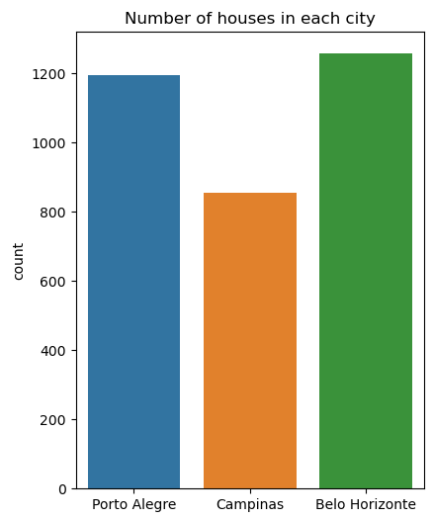

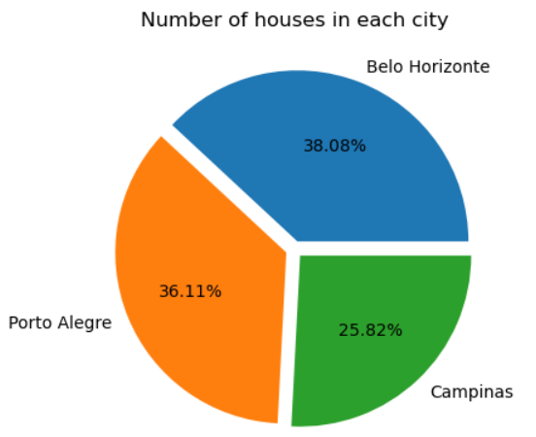

City-wise houses
Percentage of available houses by city
Count of available houses by city
Interpretation :
38% of houses are in Belo Horizonte city, 36% houses are in Porto Alegre and 26% are in Campinas city.

Slide 8
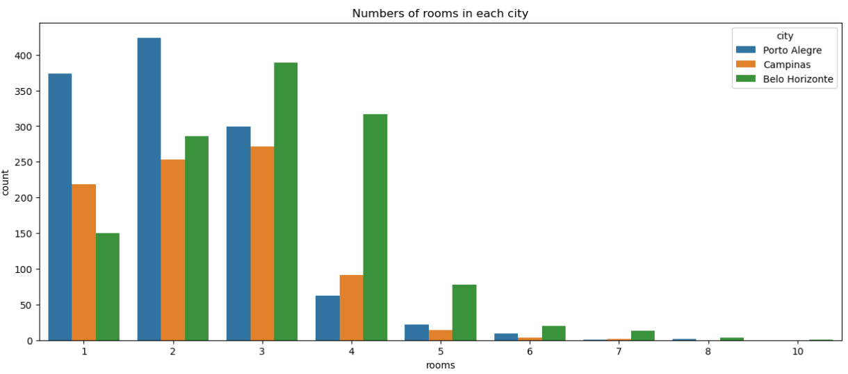
Number of houses based on room count, categorized by city.
Interpretation :
The maximum number of houses available for rent is in Porto Alegre city

Slide 9
Select the suitable cities for relocating bachelors.
Considering some of the house requirements for Bachelors in different cities :
Requirements | Quantity
Rooms | 1
Bathrooms | 1
Interior | Furnished Interior
Parking Space | No Parking

Slide 10
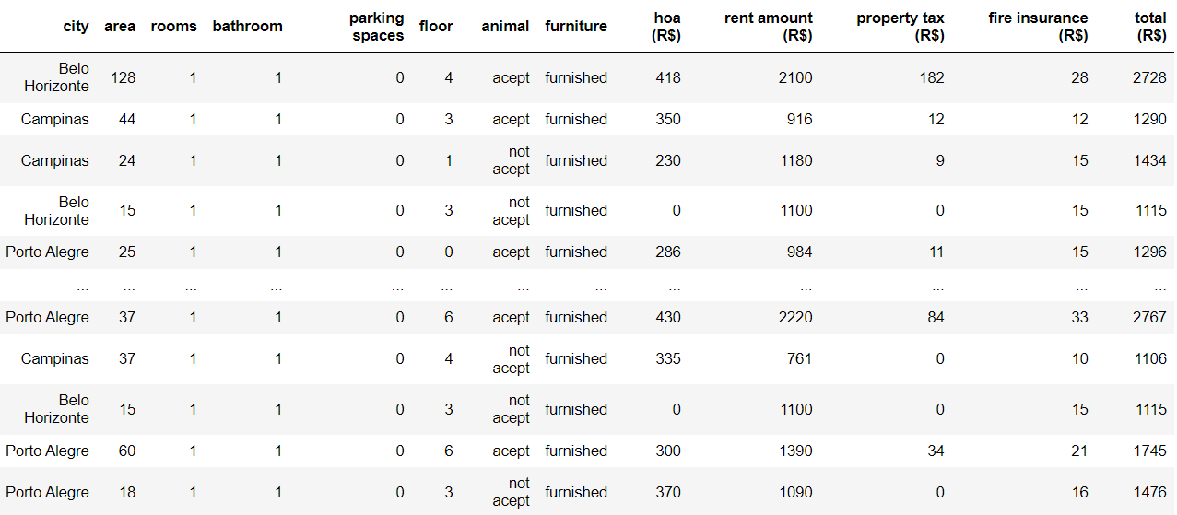
FILTERED DATA

Slide 11
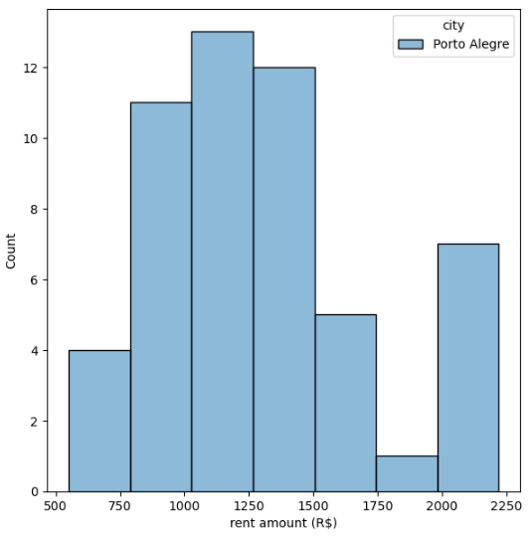
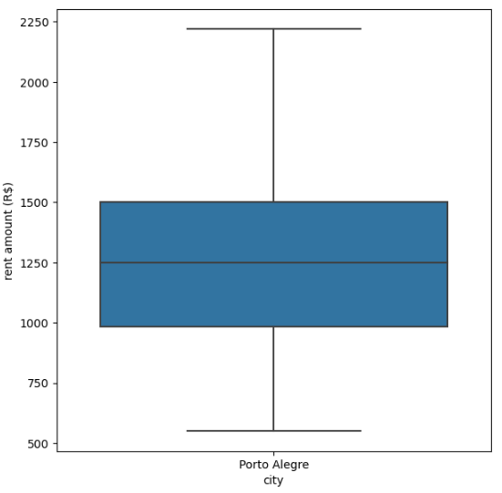
City – Porto Alegre
Box plot of available houses for bachelors.
Count plot of available houses for bachelors.
Interpretation :
Porto Alegre is a budget-friendly city for relocating bachelors.

Slide 12
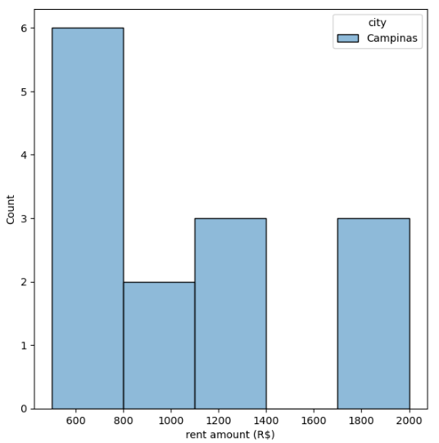
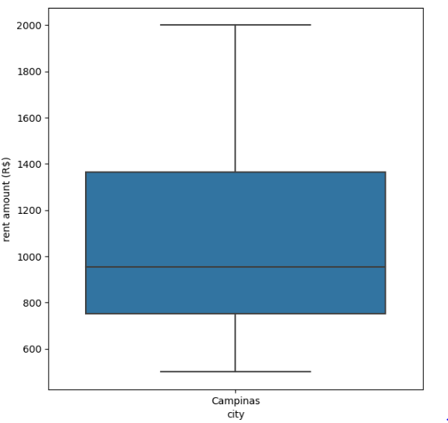
City – Campinas
Box plot of available houses for bachelors.
Count plot of available houses for bachelors.
Interpretation :
Campinas is a budget-friendly city for relocating bachelors, and there are few houses available.

Slide 13
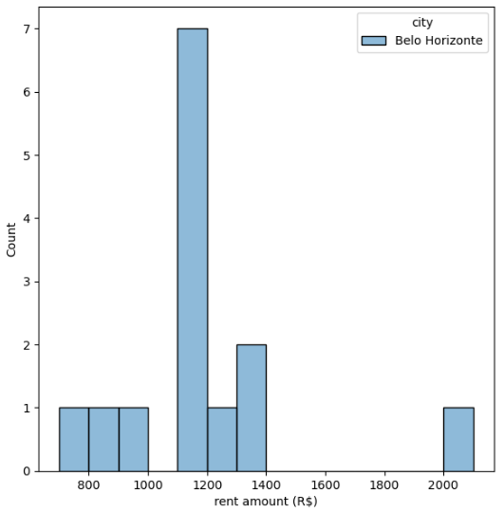
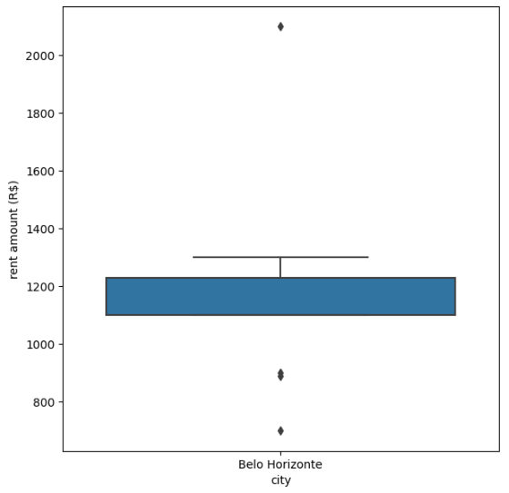
City – Belo Horizonte
Box plot of available houses for bachelors.
Count plot of available houses for bachelors.
Interpretation :
Belo Horizonte is a budget-friendly city for relocating bachelors.

Slide 14

Interpretation :
The budget for suitable houses in Porto Alegre for bachelors is 750 to 1500.
The budget for suitable houses in Campinas for bachelors is 600 to 1400.
The budget for suitable houses in Belo Horizonte for bachelors is 800 to 1400.
The majority of available houses are in Porto Alegre city, and some houses are also available in Campinas city.
1
2
3
4

Slide 15
Select the suitable cities for relocating mid-size families.
Considering some of the house requirements for Mid-size families in different cities :
Requirements | Quantity
Rooms | 2 or 3
Bathrooms | 2
Interior | Furnished Interior
Parking Space | 1

Slide 16
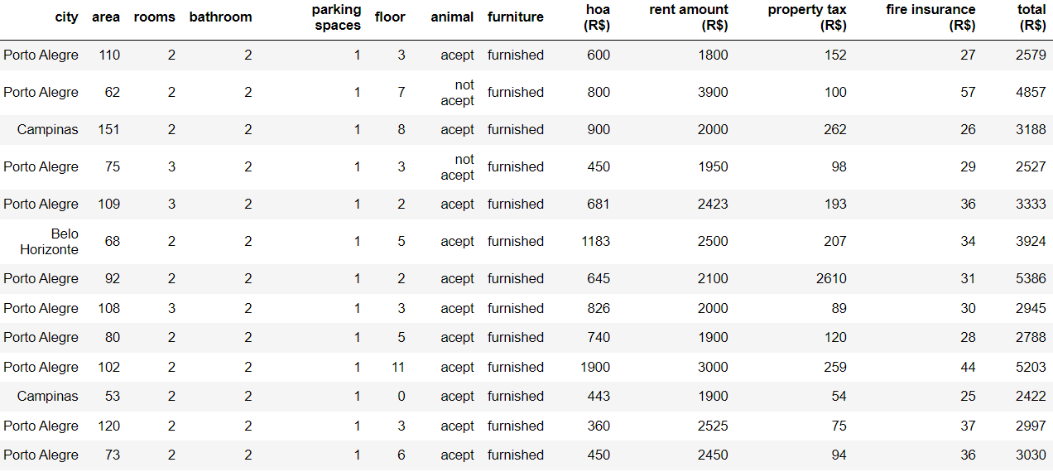
FILTERED DATA

Slide 17
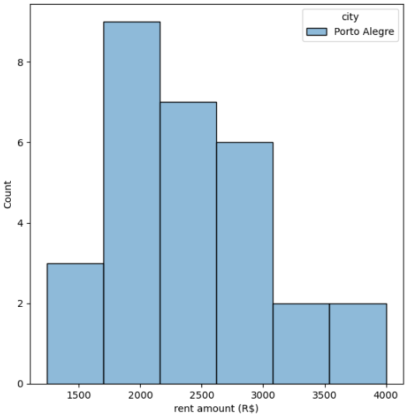
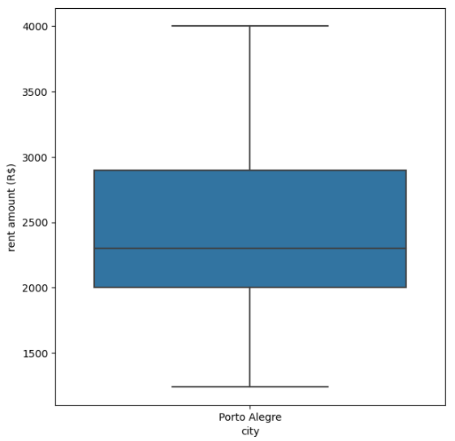
City – Porto Alegre
Box plot of available houses for
MID-SIZE FAMILIES.
Count plot of available houses for
MID-SIZE FAMILIES
Interpretation :
Porto Alegre is a budget-friendly city for relocating mid-size families.

Slide 18
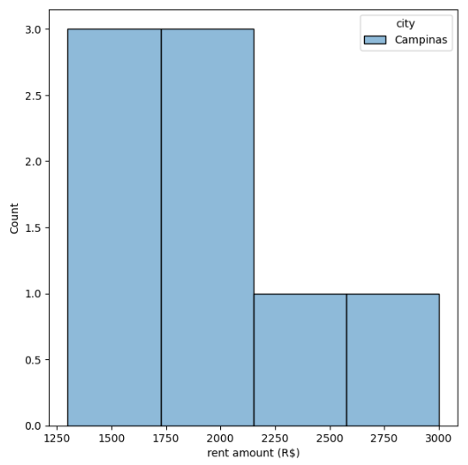
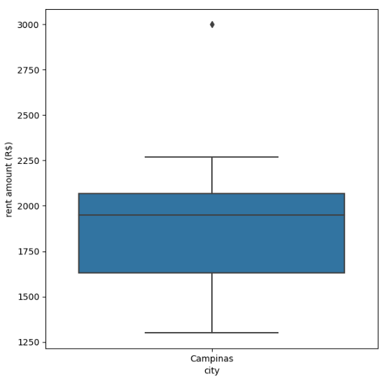
City – Campinas
Box plot of available houses for
MID-SIZE FAMILIES.
Count plot of available houses for
MID-SIZE FAMILIES
Interpretation :
Campinas is a low-budget city for relocating mid-size families, but there are very few houses available.

Slide 19
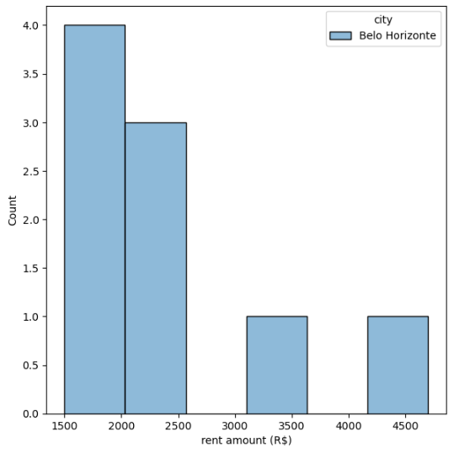
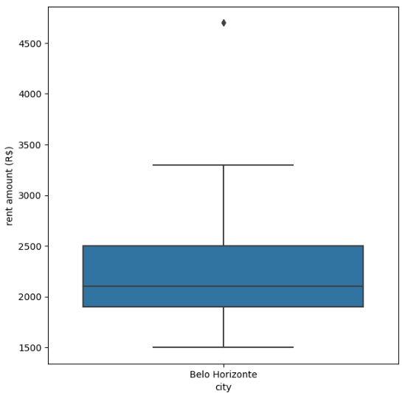
City – Belo Horizonte
Box plot of available houses for
MID-SIZE FAMILIES.
Count plot of available houses for
MID-SIZE FAMILIES
Interpretation :
Belo Horizonte is a budget-friendly city for relocating mid-size families, but there are very few houses available for rent.

Slide 20
Interpretation :
The budget for suitable houses in Porto Alegre for Mid-size families is 2500 to 4500.
The budget for suitable houses in Campinas for Mid-size families is 1600 to 3400.
The budget for suitable houses in Belo Horizonte for Mid-size families is 1500 to 4500.
The majority of available houses for Mid-size families is in Porto Alegre city.
1
2
3
4

Slide 21
Select the suitable cities for relocating large-size families.
Considering the house requirements for large-size families in different cities :
Requirements | Quantity
Rooms | > 3
Bathrooms | > 2
Interior | Furnished Interior
Parking Space | > 2
Animal | Accepted

Slide 22
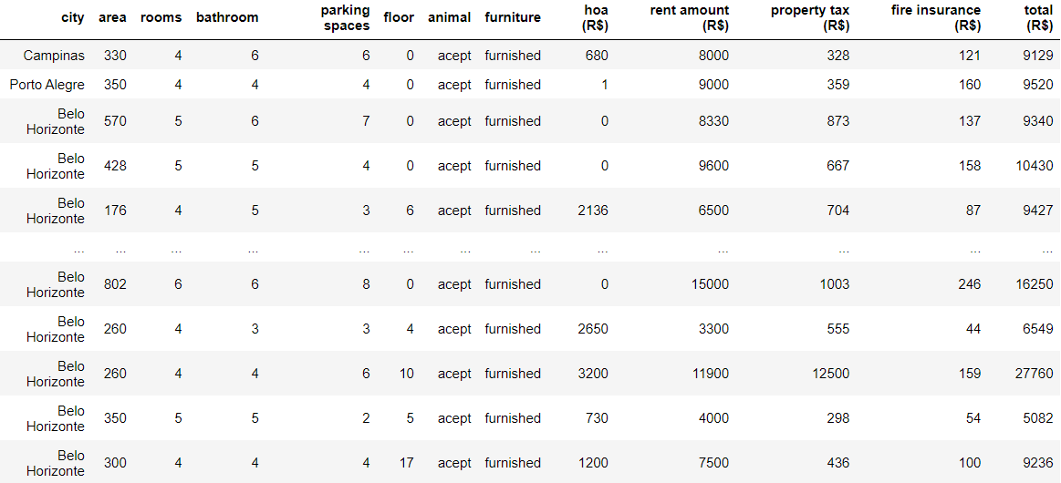
FILTERED DATA

Slide 23
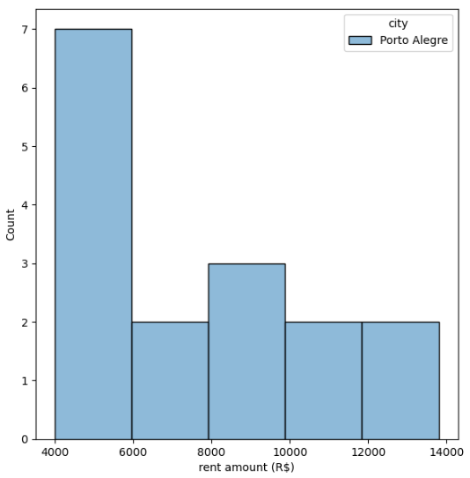
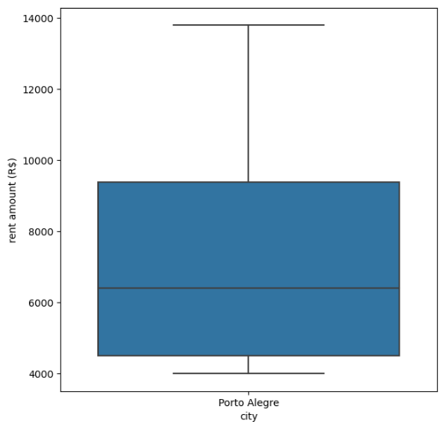
City – Porto Alegre
Box plot of available houses for
LARGE-SIZE FAMILIES.
Count plot of available houses for
LARGE-SIZE FAMILIES.
Interpretation :
There are few houses available in Porto Alegre for relocating large-size families at a lower rental price.

Slide 24
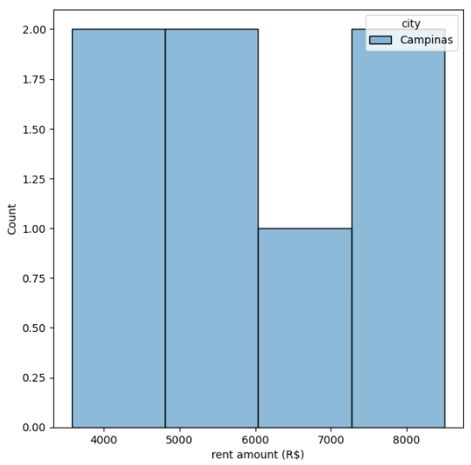
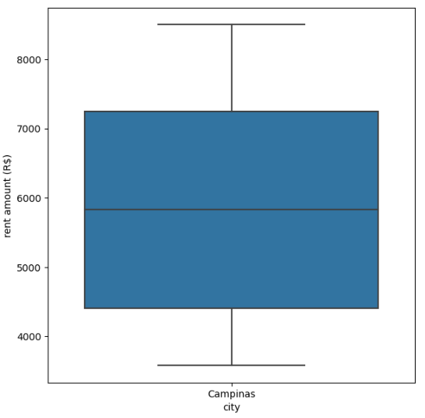
City – Campinas
Box plot of available houses for
LARGE-SIZE FAMILIES.
Count plot of available houses for
LARGE-SIZE FAMILIES.
Interpretation :
Campinas is a budget-friendly city for large-size families to relocate, but there are very few houses available for rent.

Slide 25
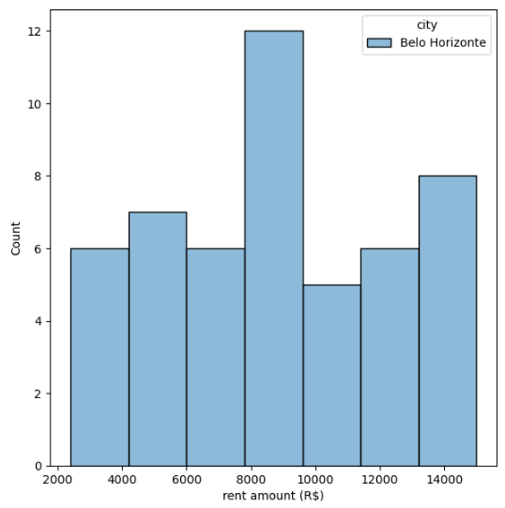
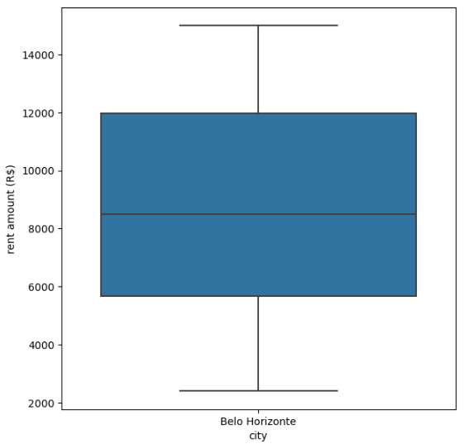
City – Belo Horizonte
Box plot of available houses for
LARGE-SIZE FAMILIES.
Count plot of available houses for
LARGE-SIZE FAMILIES.
Interpretation :
Belo Horizonte is a good city for relocating large-size families, and the budget is also not excessively high.

Slide 26
Interpretation :
The budget for suitable houses in Porto Alegre for Large-size families is 4000 to 14000.
The budget for suitable houses in Campinas for Large-size families is 4000 to 8000.
The budget for suitable houses in Belo Horizonte for Large-size families is 3000 to 14000.
The majority of available houses for Large-size families is in Belo Horizonte city.
1
2
3
4

Slide 27
Recommendation
Porto Alegre is a budget-friendly city for relocating bachelors and mid-size families. Belo Horizonte is also a good choice for bachelors, but the number of available houses for rent is very low there.
Belo Horizonte and Campinas are good and budget-friendly choices for relocating mid-size families, although there is a limited availability of houses for rent. Porto Alegre is also a favourable option for relocating mid-size families.
Belo Horizonte is a good choice for relocating large-size families. Campinas and Porto Alegre are also budget-friendly cities, but there is a limited availability of houses for rent.

Slide 28

Thank you…!

